Slide 1
Acute modulation of the cholinergic system
in the mouse brain detected by
pharmacological resting-state functional MRI

Slide 2
01
Part ONE
Introduction
Background
Research content
Subjects
Method

Slide 3

NeuroImage
Disha Shah ,2015
Cholinergic system
Learning & memory
Severe affected by AD
ACh (neurotransmitter) & mAChR (most AD-affected)
Antagonist → Scopolamine
Agonist → Milameline
Male C57bl/6 mice
Ph rsfMRI EPI
Anesthetized & Injected
Passive avoidance learning
Notes:
Cholinergic system：主要分布边缘系统和大脑皮层 隔区-海马体-边缘叶
学习记忆 海马体呈现Q节律波 分化加速
Scopolamine 消除Q节律波 把训练好并巩固的学习过程遗忘 近期遗忘症
抑制剂 激动剂 乙酰胆碱 胆碱能系统（神经系统释放乙酰胆碱作为神经递质）Ach：acetylcholine

Slide 4
02
Part TWO
Analysis
Identify brain regions scopolamine induce intensity changes
Evaluate the effects of scopolamine on FC
Whether scopolamine-induced memory effect could be
reversed with milameline

Slide 5
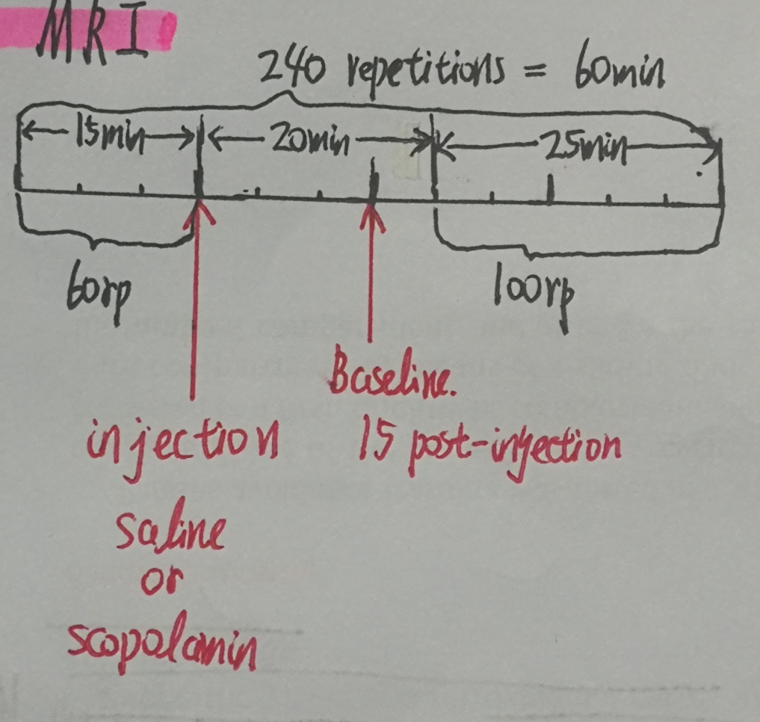
Ph MRI
N = 10/group
Analysis:
Pre-&post-injection statistic difference map
Group : saline & scopolamine
Two levels:
First:
for each subject
Second:
mean for group
A T2* weighted EPI

Slide 6
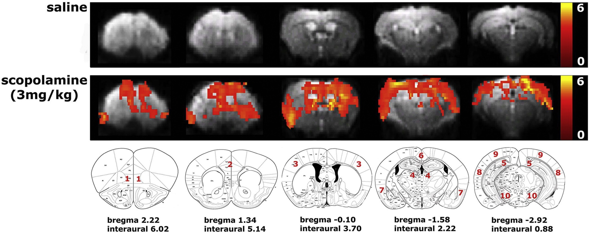
Paired-t test
Saline-injected group : no significant signal intensity differences between pre-injection and post-injection.
Scopolamine-injected group: significant decreases in
signal intensity were observed.
Between pre&post
Respective to saline &scopolamine
Regions affected by scopolamine:
Significantly: several cortical regions & hippocampus
Partly : thalamus
No : ventral tegmental area/substantia nigra
(VTA/SN)
Color scale: T values

Slide 7
Paired-t test
Between pre&post
Respective to saline &scopolamine
Several cortical regions :
OFC: Orbitofrontal cortex
Cg: Cingulate cortex
SS: Somatosensory cortex
Resp: Retrosplenial cortex
AC: Auditory cortex
VC: Visual cortex
RC: Rhinal cortex
Hippocampus
Color scale: T values

Slide 8
02
Part TWO
Analysis
Identify brain regions where scopolamine induce intensity changes
Evaluate the effects of scopolamine on FC
Whether scopolamine-induced memory effect could be reversed with milameline

Slide 9
Ph rsfMRI
A T2* weighted EPI
N = 15/group
Injection :
Saline
Scopolamine
Methyl-scopolamine
Scans:
Acquired: 25 min post-injection
ROI analysis :
Regions found in last step:
Cortical regions
Hippocampus
VTA/SN as control region
Comparison between:
Saline-injected FC
Scopolamine-injected FC

Slide 10
Ph rsfMRI
Part ONE: ROI-based analysis
Cortial regions and hippocampus as ROI
FC between ROIs
Individual correlation matrices by calculating the correlation coefficient between time traces of each pair of ROIs
Mean z-transformed FC matrices per group
-- FDR correction to correct for multiple comparison

Slide 11
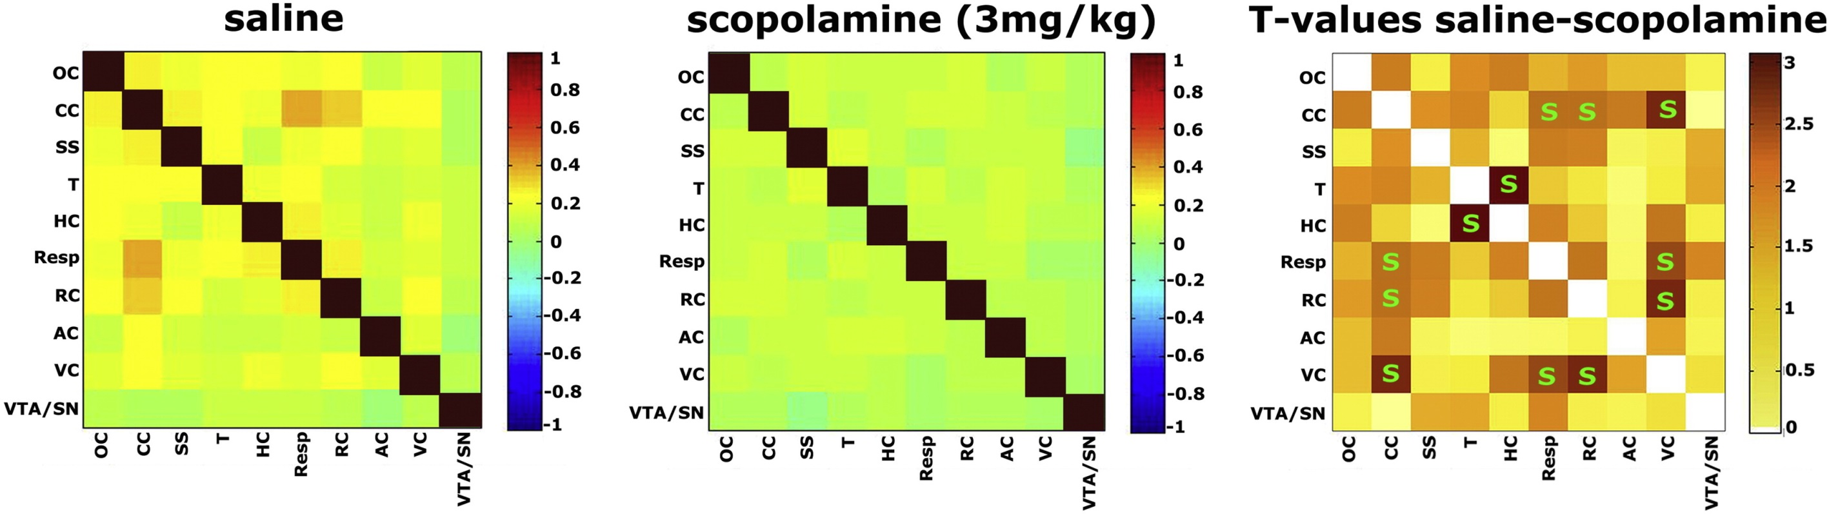
Ph rsfMRI acquired
25 min post-injection
Two-sample t test

Slide 12
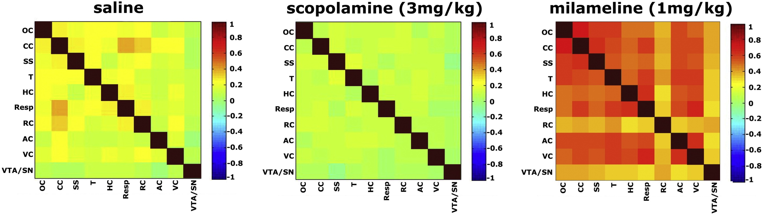
Ph rsfMRI acquired
25 min post-injection
Milameline caused an increase in brain FC.

Slide 13
Ph rsfMRI
Part TWO: Seed-based analysis
Two ways:
Seed regions with the whole brain
Seed regions with each other
Seed regions chosen:
Left Hippocampus
Left cingulate cirtex
Visual cortex
Into three group according to injection:
Saline &Scopclamine &Methyl-scopolamine

Slide 14
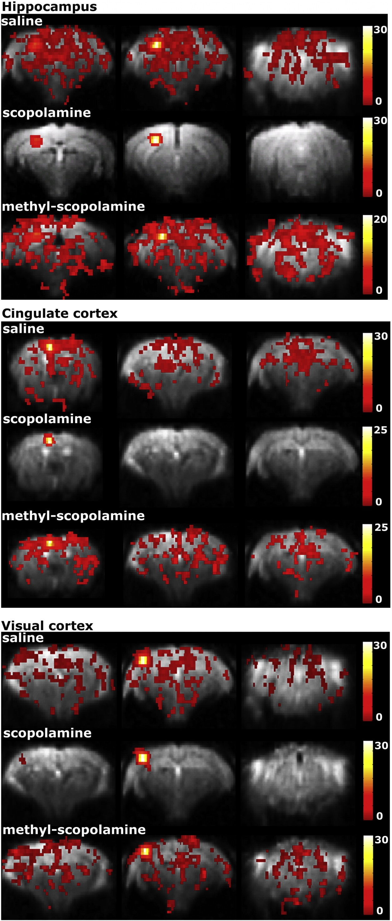
Ph rsfMRI
Ph rsfMRI acquired
25 min post-injection
Seed regions with the whole brain
Mean zfc-map
Per/Inter-group FDR correction
Inter-group One-way ANOVA
Color scale:
t value
Strength of FC

Slide 15
Ph rsfMRI
Seed regions with the whole brain
Reasons for the use of methyl-scopolamine:
Scopolamine has peripheral effects on cardiovascular function and causes vasoconstriction .
Peripheral and central effects
Notes:
This means that the observed effects of scopolamine on brain FC are possibly a combination of
peripheral and central effects.

Slide 16
Ph rsfMRI
Seed regions with the whole brain
Methyl-scopolamine used to evaluate the peripheral effects of scopolamine on brain FC.
Methyl-scopolamine shows the same mAChR binding characteristics as scopolamine but does not readily cross the blood–brain–barrier.

Slide 17
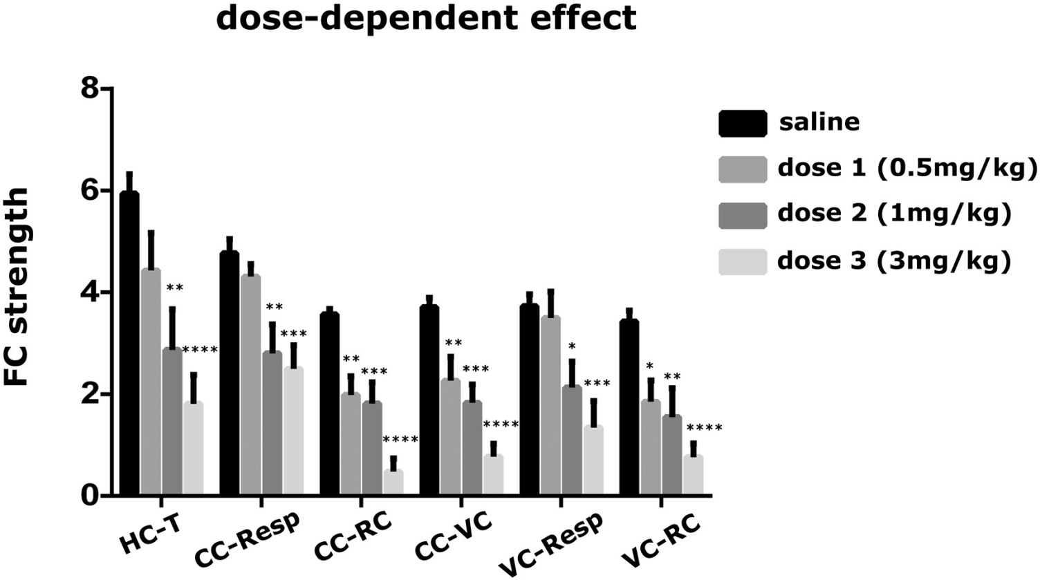
Ph rsfMRI
Tukey correction
One –way ANOVA
Seed regions with each other
Mean zfc-map for each subjectS
Mean Zfc-map for seed region A
Calculate by a mask for region B
FC between region A &B
Decrease caused by scopolamine is
dose-dependent.
Notes:
which reached statistical significance starting from the dose of 1 mg/kg for all the assessed functional connections. Furthermore, FC decreases reached statistical significance
starting from the lowest dose of 0.5 mg/kg for FC between the cingulate and rhinal cortex, between the cingulate
and visual cortex and between the visual and rhinal cortex.

Slide 18
02
Part TWO
Analysis
Identify brain regions where scopolamine induce intensity changes
Evaluate the effects of scopolamine on FC
Whether scopolamine-induced memory effect could be reversed with milameline

Slide 19
Behavior Study
– Passive avoidance learning
Dark compartment
Brightly lit compartment
After 24 hour:
Escape latency
Re-enter time :
up to 300s
Slide door
Open
Put mice here → After 5s → If mice complete entry into here → A slight foot shock
(4-paw critetion)

Slide 20
Ph rsfMRI
Design 1:
N = 12/group
Baseline : 15 min post-injection
Scopolamine administered
25 min later: Ph rsfMRI
Milameline administered
25 min later: Ph rsfMRI
Design 2:
Three groups:
Saline
Scopolamine
Milameline
N = 8/group

Slide 21
Behavior Study
& Ph rsfMRI
Passive avoidance test for each group twice respectively on
Training day
Testing day (test 55 min after first injection)
A paired-t test between the re-enter time for each group

Slide 22
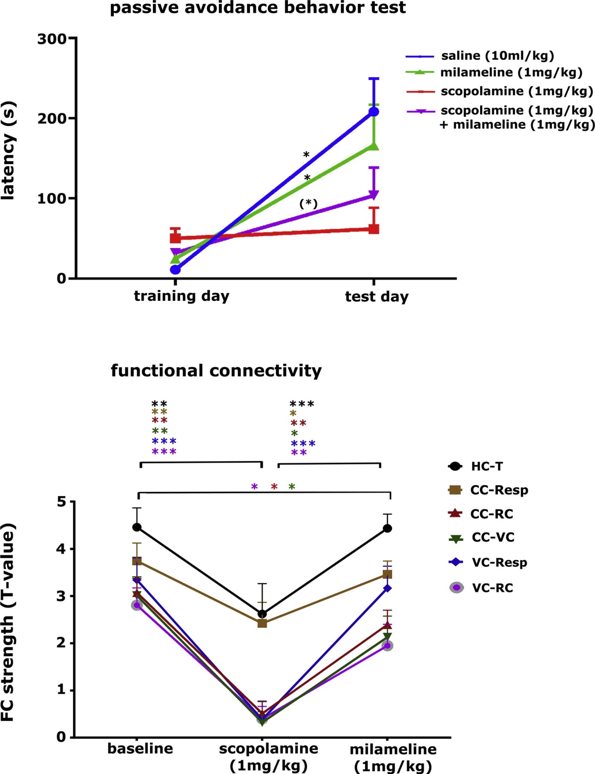
Behavior Study
& Ph rsfMRI
A significant increase in latency for saline & milameline injected group
No significant increase in latency for scopolamine injected group
An increased latency showed for group injected first scopolamine and second milameline

Slide 23
FC between seed regions from last part
After milameline injected:
Completely recover:
HC-T
CC-Resp
VC-Resp
Not completely recover:
CC-RC
CC-VC
VC-RC
Behavior Study
& Ph rsfMRI

Slide 24
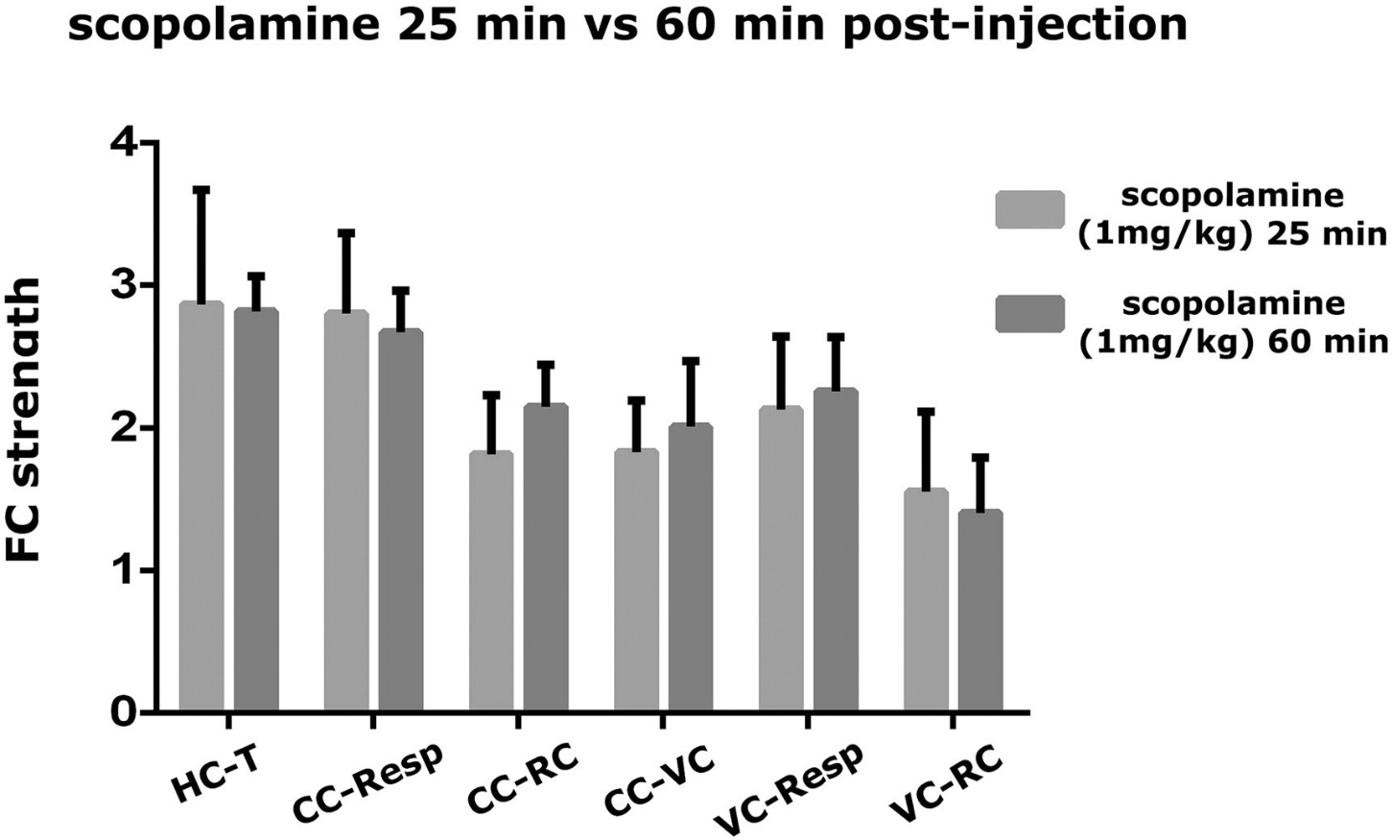
Design 3:
N = 10/group
Scan ：
60 min after scopolamine administered
Behavior Study
& Ph rsfMRI

Slide 25
03
Part THREE
Conclusion
Topics
Supplementary

Slide 26
Scopolamine can induce memory effects.
Scopolamine-caused memory effects could be reversed with milameline.
Identify scopolamine-affected regions
Scopolamine can induce FC intensity decrease.
Milameline can induce FC intensity increase.
Decrease in FC intensity caused by scopolamine is not effected by peripheral factors.
Decrease caused by scopolamine is dose-dependent.
Topics

Slide 27
Supplementary
Doses chosen
Intensity changes observed partly in the thalamus
Intensity differences ,not extensive
VTA/SN, no intensity difference
Some different results in human and rodents
Some region affected by low dose of scopolamine, vulnerable, target
Notes:
Previos study
Signal spreading from hippocampus
The use of anesthesia
Distortion,low signal-to-noise ratio

Slide 28
Thank you all for listening~

